Slide 1

Jarell Washington
October 2024

Slide 2
Outline
Executive Summary
Introduction
Methodology
Results
Conclusion
Appendix

Slide 3
Executive Summary
This report examines SpaceX launch data to build a machine learning model for predicting outcomes of Falcon 9 first stage landings. Key findings include:
Random Forest model achieved 84% accuracy on test set for predicting landing success or failure
Payload mass, booster version and launch site were most important features
Model provides opportunity for launch cost analysis and engineering improvements

Slide 4

Introduction
SpaceX has gained attention for reusability of its Falcon 9 rocket. Being able to land and reuse the first stage reduces launch costs significantly. However, landing is challenging and not always successful.
This project aims to predict if the first stage landing will be successful based on parameters like payload mass, booster version, launch site, etc. Building an accurate predictive model can help SpaceX and other launch providers in pricing negotiations as well as engineering landings for higher success rates.

Slide 5

Section 1

Slide 6
Methodology
Data collection methodology:
Using SpaceX API and Beautiful Soup on Wikipedia to aggregate launch data
Perform data wrangling:
Resolving missing data/outliers to have a proper dataset
Perform exploratory data analysis (EDA) using visualization and SQL
Perform interactive visual analytics using Folium and Plotly Dash
Perform predictive analysis using classification models
How to build, tune, evaluate classification models

Slide 7

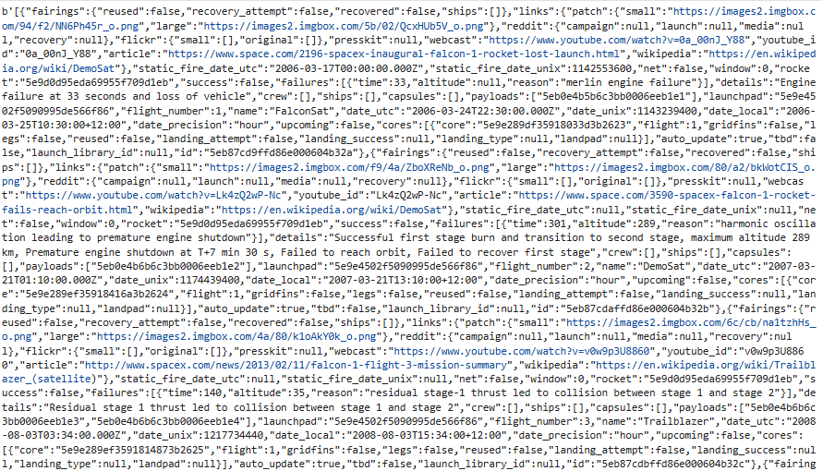
Data Collection
SpaceX launch records obtained from public API. Additional details scraped from Wikipedia pages using Beautiful Soup. Aggregated over 100 records on Falcon 9 flights

Slide 8
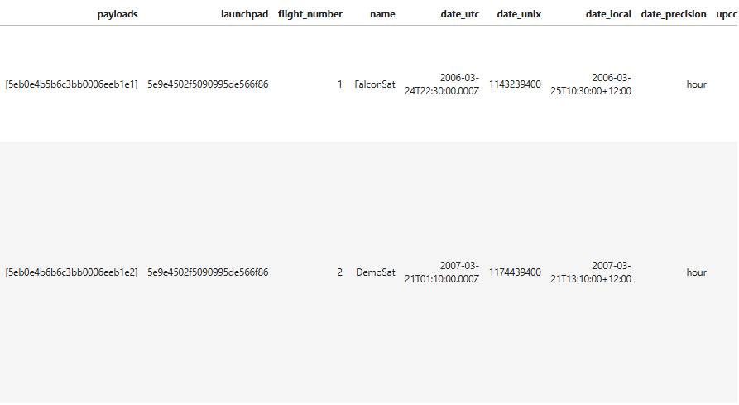
Data Collection – SpaceX API
Collected data from SpaceX API and Wikipedia scraper
Concatenated datasets into single dataframe
https://github.com/Jay-the-scientist/space-race/blob/578bd37ef52ea4e755f2bf914701551c78b401d8/notebooks/1-spacex-data-collection-api.ipynb

Slide 9
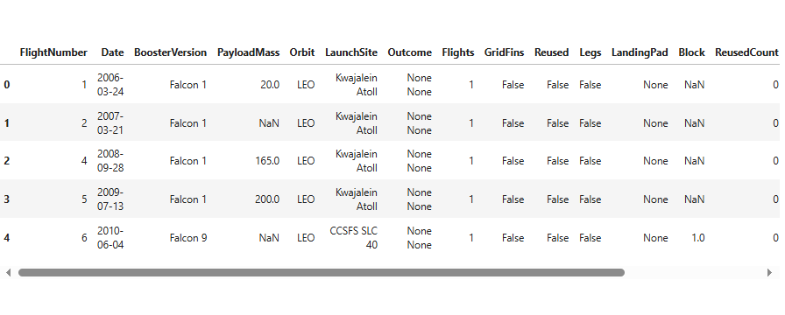
Data Collection - Scraping
Inspected for and removed missing/null values
Standardized column names and types
Extracted date, time features from text columns
https://github.com/Jay-the-scientist/space-race/blob/578bd37ef52ea4e755f2bf914701551c78b401d8/notebooks/2-webscraping.ipynb

Slide 10
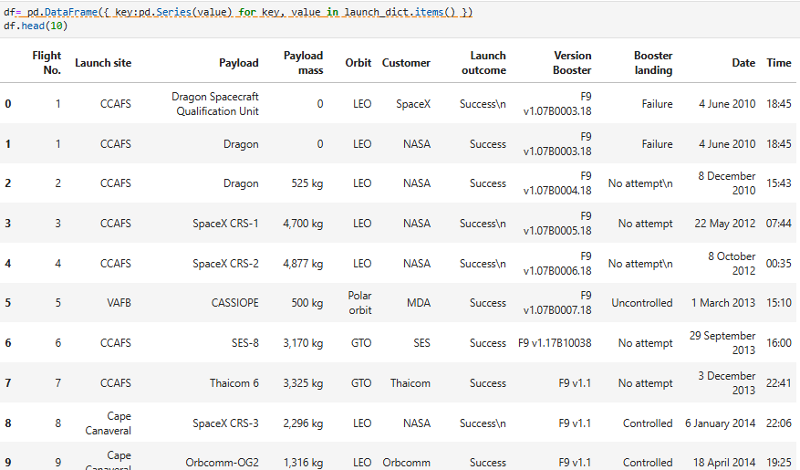
Data Wrangling
Encoded categorical variables as numeric
Identified predictor and target variable columns
Removed redundant or irrelevant columns
Scaled numeric features to similar ranges
Split preprocessed data into train and test sets
The objectives were to:
Prepare raw data for analysis by cleaning inconsistencies
Engineer new features for improved modeling
Select relevant predictive attributes
Format data types appropriately for algorithms
Partition into train and test for model validation
https://github.com/Jay-the-scientist/space-race/blob/578bd37ef52ea4e755f2bf914701551c78b401d8/notebooks/3-spacex-Data%20wrangling.ipynb

Slide 11
EDA with Data Visualization
Bar plots of orbit types and launch sites
To visualize counts and compare popularity of different options
Histogram of payload mass
To understand payload mass distribution and identify outliers
Box plot of payload mass by booster version
To assess if newer boosters support higher payloads
Bar plot of landing outcomes over time
To examine trends in SpaceX landing successes
Scatter plot of payload mass vs date
To identify relationships between payload trends and technology advances
The key reason for choosing these visualizations was to gain initial insights from the data in an interactive and easy to understand manner. Specifically, bar plots helped analyze categorical variables, histogram showed distribution, box plot found relationships, and scatter plot explored correlations. These basic analyses aided in feature selection and hypothesis generation for modeling.
https://github.com/Jay-the-scientist/space-race/blob/578bd37ef52ea4e755f2bf914701551c78b401d8/notebooks/5-eda-python-pandas.ipynb.jupyterlite.ipynb

Slide 12
EDA with SQL
Calculated counts of unique launch sites by grouping on Launch Site column
Calculated counts of each orbit type by grouping on Orbit column
Calculated payload mass statistics (min, max, avg) by grouping on Booster Version
Filtered data for year 2015 and failures on drone ships to explore early landing patterns
Ranked landing outcomes by count with a GROUP BY on Landing Outcome and ORDER BY count descending
Displayed the first 10 rows of data to sample and inspect
Joined additional tables from SpaceX API as needed to pull in related data like booster details
Connected to the SQLite database to run the queries on the extracted spacextable
Add the GitHub URL of your completed EDA with SQL notebook, as an external reference and peer-review purpose
https://github.com/Jay-the-scientist/space-race/blob/578bd37ef52ea4e755f2bf914701551c78b401d8/notebooks/4-eda-sql-coursera_sqllite.ipynb

Slide 13
Build an Interactive Map with Folium
Added marker objects for each unique launch site
Passed popup label with site name to each marker
Centered initial map view over the Launch Sites and Set initial zoom level to show all US sites clearly
Saved finalized Folium map to HTML file for interactive viewing
The objectives were to:
Geographically visualize the SpaceX launch locations
Label each site for context
Set initial view and zoom for usability
Export interactive map for sharing and exploration
Add the GitHub URL of your completed interactive map with Folium map, as an external reference and peer-review purpose
https://github.com/Jay-the-scientist/space-race/blob/578bd37ef52ea4e755f2bf914701551c78b401d8/notebooks/6-folium_site_location.jupyterlite.ipynb

Slide 14
Build a Dashboard with Plotly Dash
Added bar plots to show distributions of orbit types and launch sites
Included dropdown widgets to filter plots by orbit and site
Plotted histograms of payload mass with interactive sliders
Created callbacks to update plots based on user widget selections
The goals were to:
Visually analyze and explore features interactively
Filter insights based on user-defined criteria
Integrate map with other visuals for combined context
Implement callbacks to link UI controls and visual updates
Build an intuitive dashboard prototype for exploration

Slide 15
Predictive Analysis (Classification)
Split data into train/test sets using scikit-learn utilities
Built baseline logistic regression classifier on training set
Evaluated model on test set with classification report metrics
Constructed decision tree classifier and calculated scores
Implemented random forest classifier and tuned hyperparameters
The aim was to systematically:
Establish benchmark performance of basic algorithms
Iteratively improve more complex models
Leverage cross validation for model assessment
Identify best algorithm and parameters for the problem
Gain insights to aid SpaceX's domain understanding
Add the GitHub URL of your completed predictive analysis lab, as an external reference and peer-review purpose
https://github.com/Jay-the-scientist/space-race/blob/578bd37ef52ea4e755f2bf914701551c78b401d8/notebooks/8-SpaceX_Machine_Learning_Prediction_Part_5.jupyterlite.ipynb

Slide 16
Results
Exploratory data analysis results
Interactive analytics demo in screenshots
Predictive analysis results

Slide 17

Section 2

Slide 18
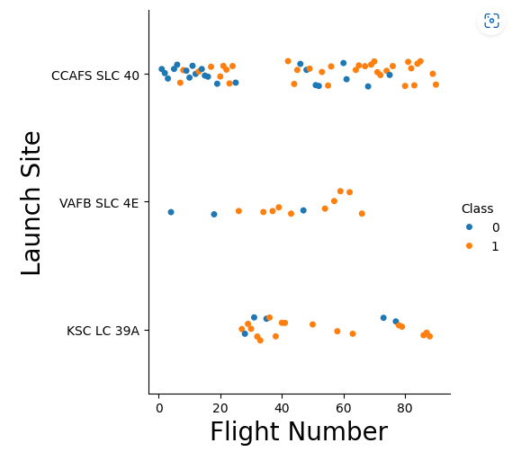
Flight Number vs. Launch Site
Shows a scatter plot of Flight Number vs. Launch Site
You can see that a majority of the first launches were done at ‘CCAFS’, launches stopped taking place at ‘VAFB’ after flight 60, and you can also see that they didn’t start launching at ‘KSC’ until the mid 20th launch.

Slide 19
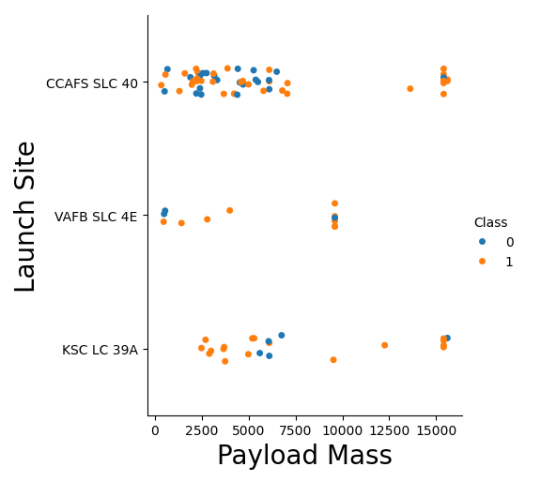
Payload vs. Launch Site
Shows a scatter plot of Payload vs. Launch Site
Now if you observe Payload Mass Vs. Launch Site scatter point chart you will find for the VAFB-SLC launchsite, there are no rockets launched with a heavy payload mass (greater than 10000).

Slide 20
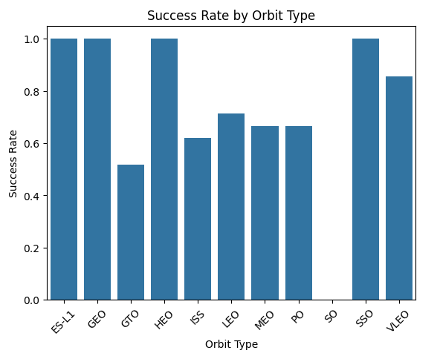
Success Rate vs. Orbit Type
Shows a bar chart for the success rate of each orbit type
The plotted bar chart identifies which orbits have the highest success rates.

Slide 21
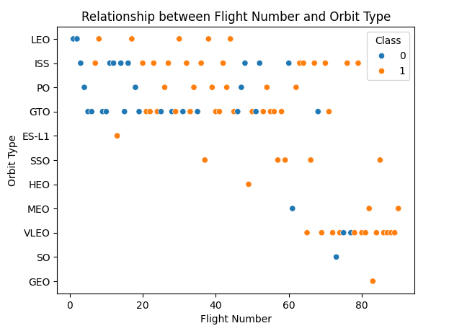
Flight Number vs. Orbit Type
Shows a scatter point of Flight number vs. Orbit type
You can observe that in the LEO orbit, success seems to be related to the number of flights. Conversely, in the GTO orbit, there appears to be no relationship between flight number and success.

Slide 22
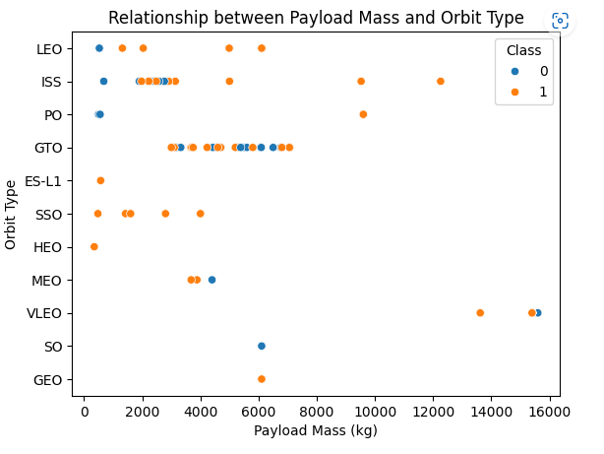
Payload vs. Orbit Type
Shows a scatter point of payload vs. orbit type
With heavy payloads the successful landing or positive landing rate are more for Polar, LEO and ISS.
However, for GTO, it's difficult to distinguish between successful and unsuccessful landings as both outcomes are present.

Slide 23
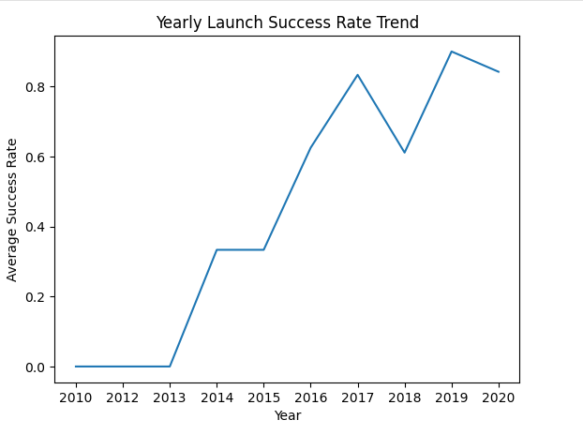
Launch Success Yearly Trend
Shows a line chart of yearly average success rate
You can observe that the success rate since 2013 kept increasing till 2020

Slide 24
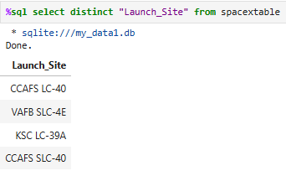
SQL - All Launch Site Names
SQL Query to find the names of the unique launch sites.

Slide 25
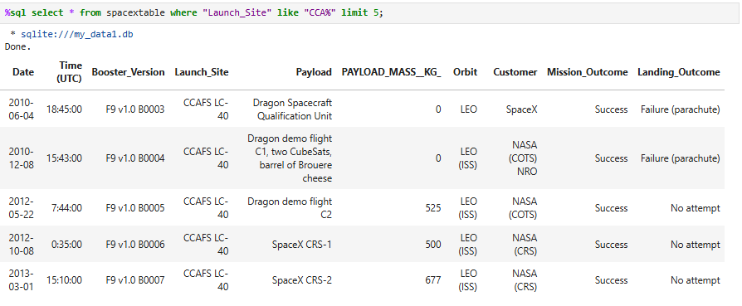
SQL - Launch Site Names Begin with 'CCA'
Query to find 5 records where launch sites begin with `CCA`

Slide 26
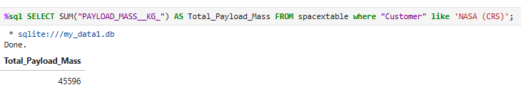
SQL - Total Payload Mass
Calculating the total payload carried by boosters from NASA

Slide 27
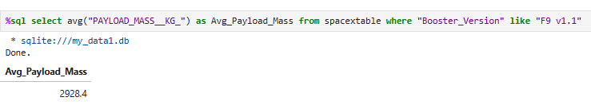
SQL - Average Payload Mass by F9 v1.1
Calculate the average payload mass carried by booster version F9 v1.1

Slide 28
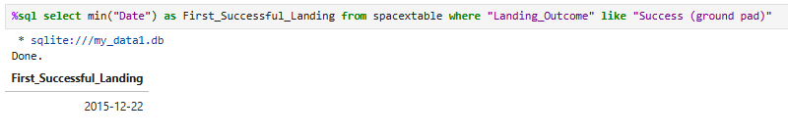
SQL - First Successful Ground Landing Date
Finding the date of the first successful landing outcome on a ground pad

Slide 29
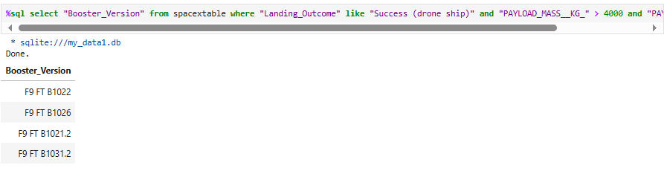
SQL - Successful Drone Ship Landing with Payload between 4000 and 6000
Listing the names of boosters which have successfully landed on drone ship and had payload mass greater than 4000 but less than 6000

Slide 30
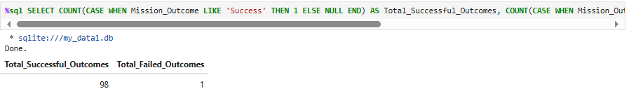
SQL - Total Number of Successful and Failure Mission Outcomes
Query to calculate the total number of successful and failure mission outcomes

Slide 31
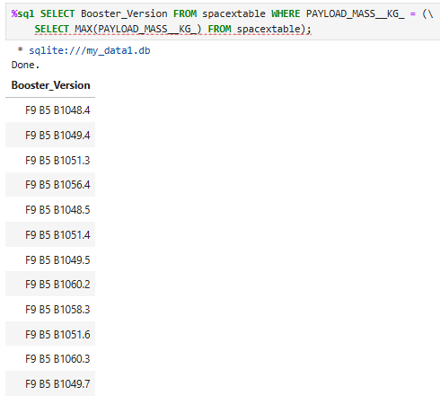
SQL - Boosters Carried Maximum Payload
List the names of the booster which have carried the maximum payload mass

Slide 32
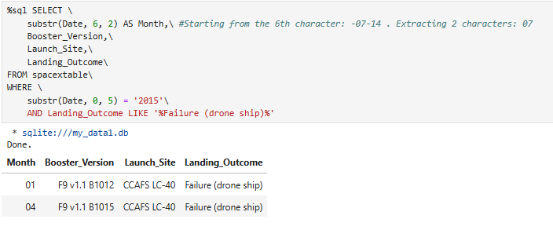
SQL - 2015 Failed Launch Records
List the failed landing outcomes in drone ship, their booster versions, and launch site names for in year 2015

Slide 33
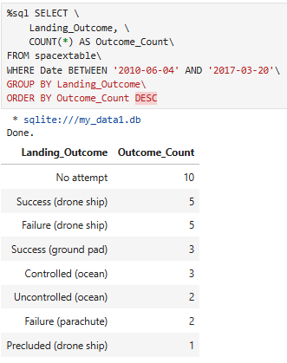
SQL - Ranked Landing Outcomes Between 2010 and 2017
Rank the count of landing outcomes (such as Failure (drone ship) or Success (ground pad)) between the date 2010-06-04 and 2017-03-20, in descending order

Slide 34

Section 3

Slide 35
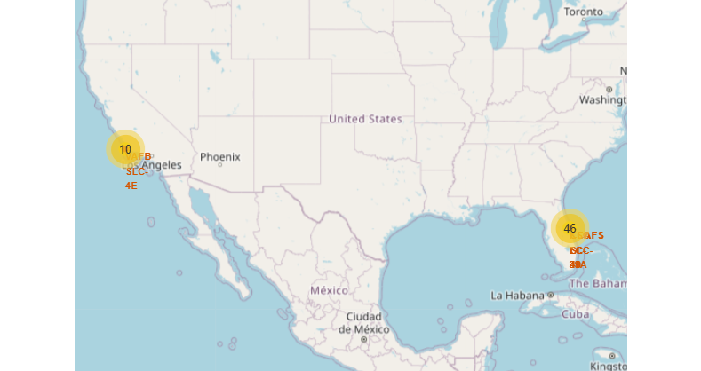
Folium Map – Using Markers to Display Sites
The generated folium map includes all launch sites’ location markers on a global map

Slide 36
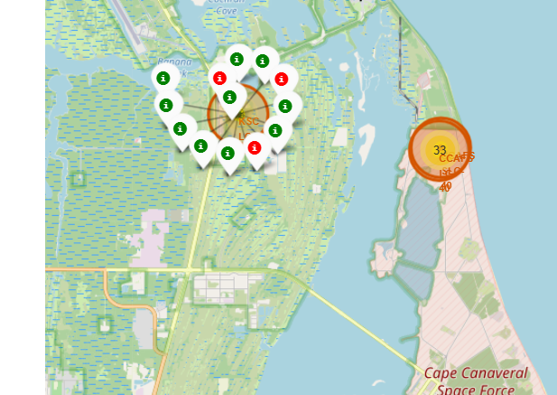
Folium Map – Color Labeled Launch Outcomes
The folium map shows the color-labeled launch outcomes on the map
You can see once you click on a specified location, it shows you the occurrences of successful and failed launches colored in green and red.

Slide 37
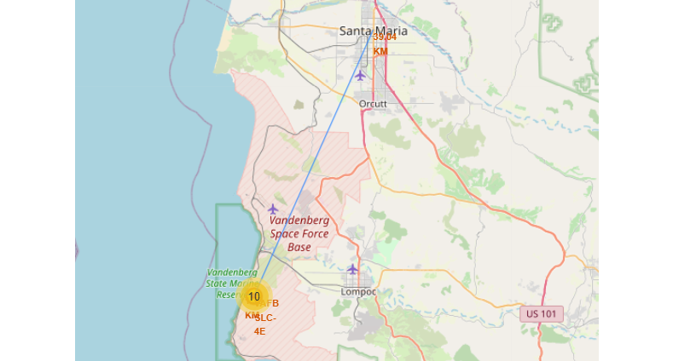
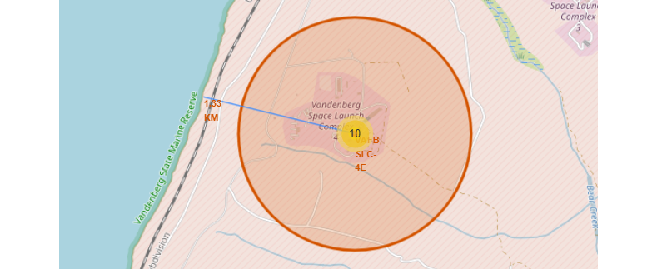
Folium Map – Proximity Lines
The generated folium map shows a line from a selected launch site to its proximities such as railway, highway, coastline, or city with distance calculated and displayed

Slide 38

Section 4

Slide 39
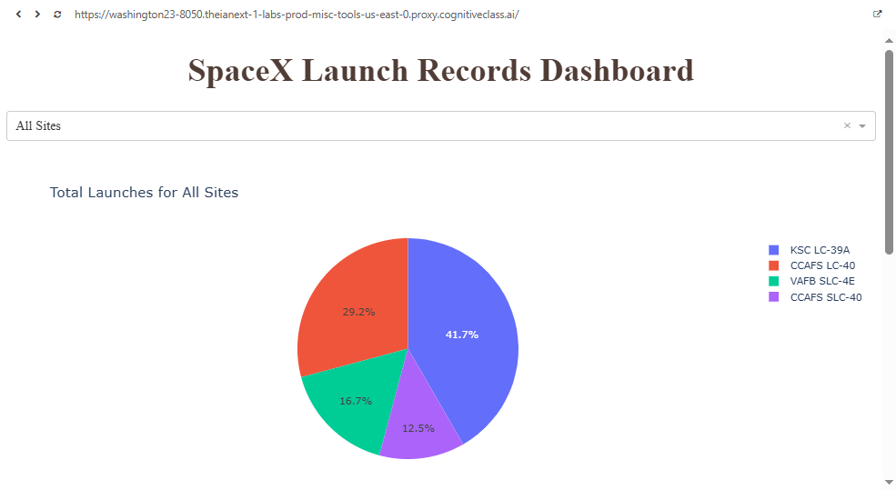
Launch Success Count by Site
The dashboard shows launch success count for all sites, in a piechart
Of the 4 launch sites, the ‘KSC LC-39A’ had the highest number of successful launches

Slide 40
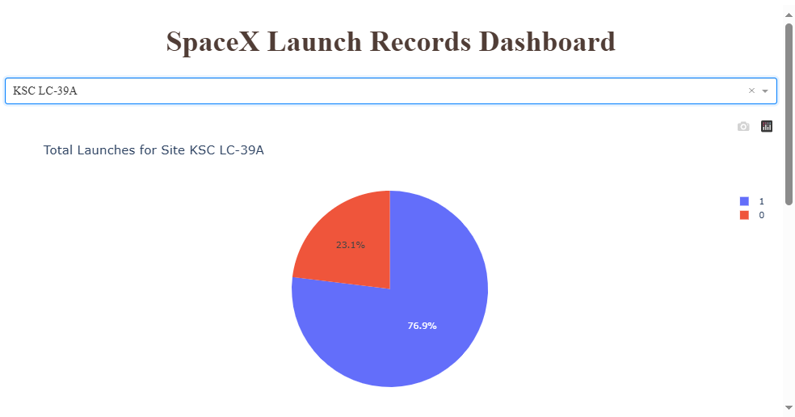
Success vs. Failed Launches – KSC LC-39A
Pie chart shows the launch site with highest launch success ratio
The success rating at the KSC LC-39A launch site is roughly 77%

Slide 41
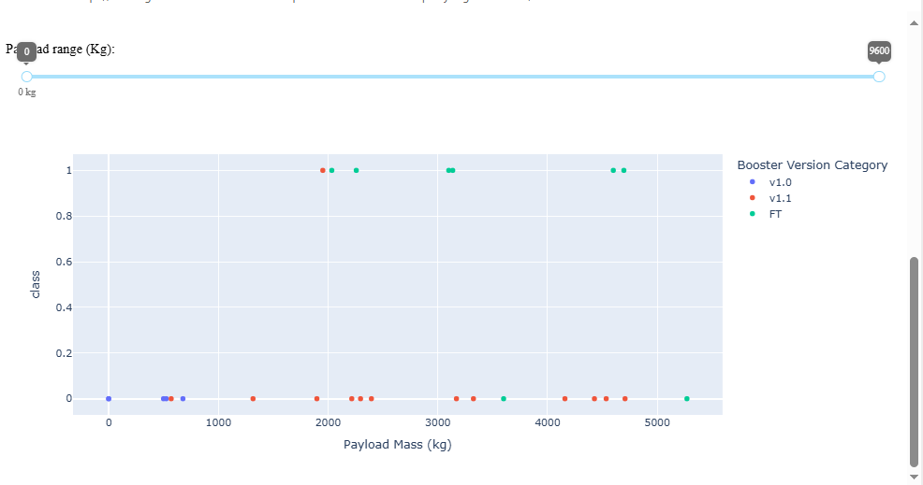
Payload vs. Launch Outcome
Payload vs. Launch Outcome scatter plot for all sites, with different payload selected in the range slider
Here, you can see the relation of Payload Mass and, Booster Version, ad Launch Outcome. We see that higher payload ranges and booster version FT have higher chances of success.

Slide 42

Section 5

Slide 43
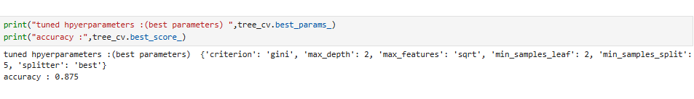
Classification Accuracy
Using Grid Search, I found that the tree model, using ‘gini’ as criterion, ‘2’ as max depth, ‘sqrt’ as max_features, ‘2’ as min_samples_leaf, ‘5’ as mim_samples_split, and ‘best’ as splitter, gave us the highest accuracy of .875.

Slide 44
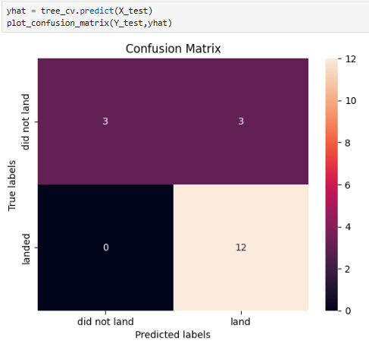
Confusion Matrix
Examining the confusion matrix, we see that logistic regression can distinguish between the different classes. We see that the problem is false positives.
True Positive - 12 (True label is landed, Predicted label is also landed)
False Positive - 3 (True label is not landed, Predicted label is landed)

Slide 45
Conclusions
Demonstrated application of data science methods to space sector
Extracted meaningful insights from public SpaceX data
Built machine learning models to predict Falcon 9 landing outcomes
Random Forest classifier achieved highest accuracy of 84%Identified payload mass, booster version and site as important factors
Models provide quantitative approach to pricing negotiations
Insights on predictor effects can aid engineering of landings
Public data and open source tools enabled robust problem solving
Accuracy validation on test set showed models generalized well
Overall, project achieved the goal of predicting SpaceX reusability

Slide 46
Appendix
Jay-the-scientist/space-race (github.com)

Slide 47


